Slide 1
Introduction to Probability and Statistics
4CM521
Means and variances of linear combination of random variables along with covariance

Slide 2
Introduction
When dealing with random variables, it's common to encounter linear combinations of these variables.
A linear combination is a mathematical expression that involves the sum and/or scalar multiplication of random variables.
Understanding the means and variances of linear combinations is crucial in various fields, including statistics and probability theory.

Slide 3
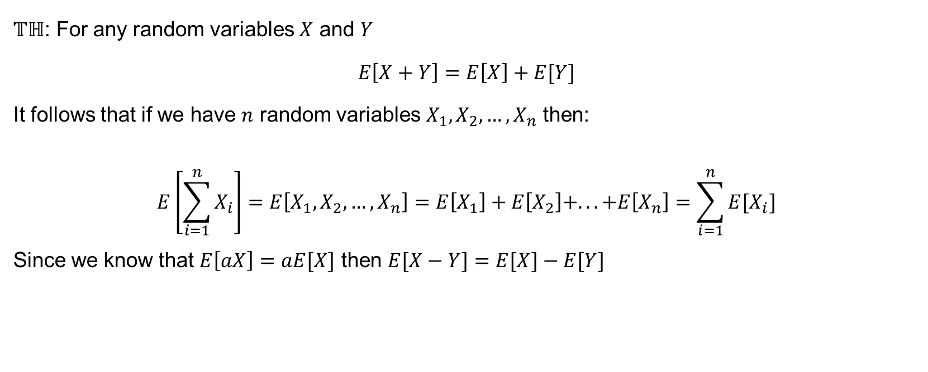
Expectation (mean) of linear combination of random
$𝕋ℍ$: For any random variables $X$ and $Y$
$$E\left[X+Y\right]=E\left[X\right]+E[Y]$$
It follows that if we have $n$ random variables $X_{1},X_{2},…,X_{n}$ then:
$$E\left[\sum_{i=1}^{n}{X_{i}}\right]=E\left[X_{1},X_{2},…,X_{n}\right]=E\left[X_{1}\right]+E\left[X_{2}\right]+...+E\left[X_{n}\right]=\sum_{i=1}^{n}{E[X_{i}]}$$
Since we know that $E\left[aX\right]=aE[X]$ then $E[X−Y]=E[X]−E[Y]$

Slide 4
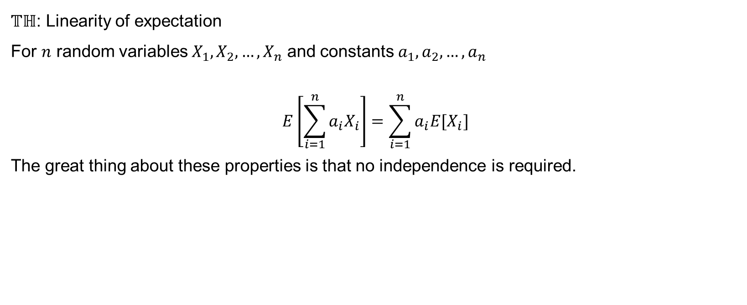
Linearity of expectation
$𝕋ℍ$: Linearity of expectation
For $n$ random variables $X_{1},X_{2},…,X_{n}$ and constants $a_{1},a_{2},…,a_{n}$
$$E\left[\sum_{i=1}^{n}{{a_{i}X}_{i}}\right]=\sum_{i=1}^{n}{a_{i}E[X_{i}]}$$
The great thing about these properties is that no independence is required.

Slide 5
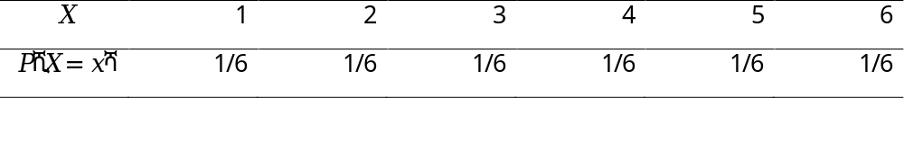
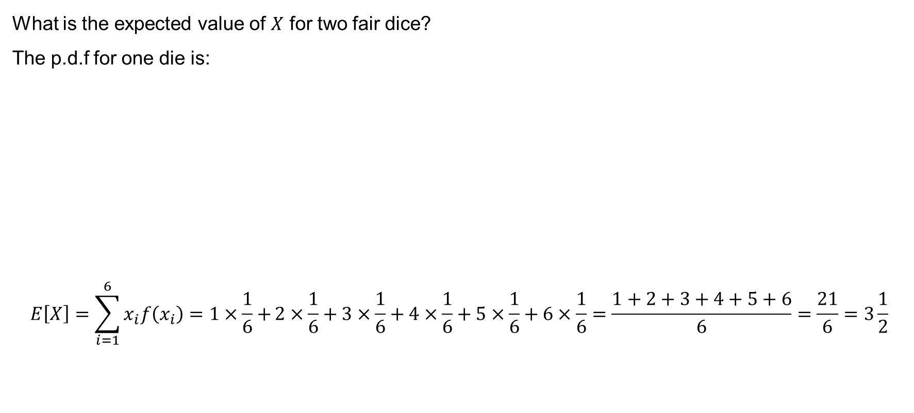
Example 9.1
What is the expected value of $X$ for two fair dice?
The p.d.f for one die is:
$$E\left[X\right]=\sum_{i=1}^{6}{x_{i}f\left(x_{i}\right)=1×\frac{1}{6}+}2×\frac{1}{6}+3×\frac{1}{6}+4×\frac{1}{6}+5×\frac{1}{6}+6×\frac{1}{6}=\frac{1+2+3+4+5+6}{6}=\frac{21}{6}=3\frac{1}{2}$$

Slide 6
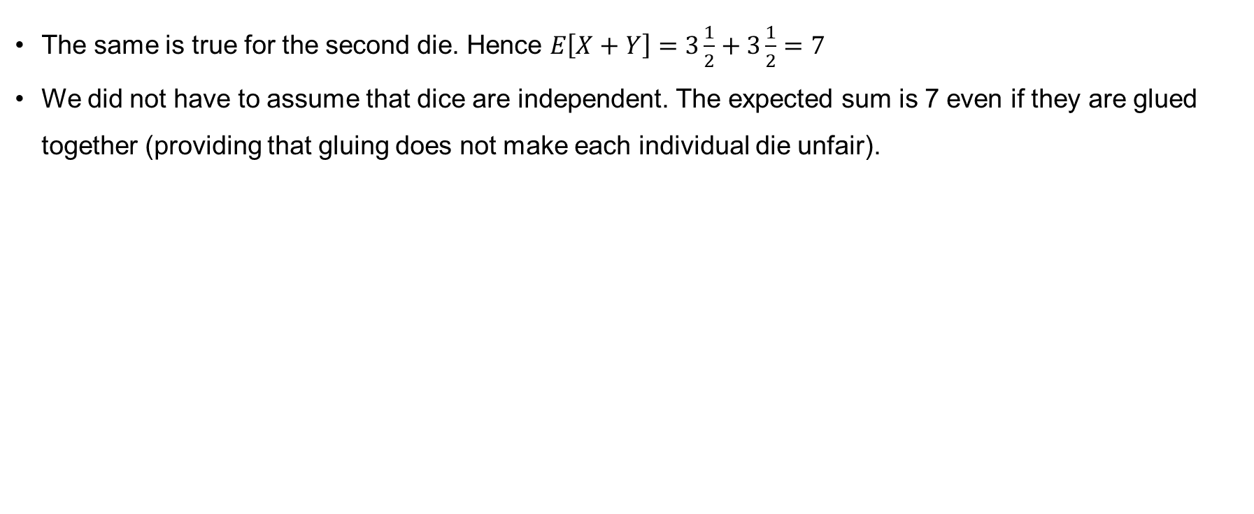
Example 9.1 (continued)
The same is true for the second die. Hence $E\left[X+Y\right]=3\frac{1}{2}+3\frac{1}{2}=7$
We did not have to assume that dice are independent. The expected sum is 7 even if they are glued together (providing that gluing does not make each individual die unfair).

Slide 7
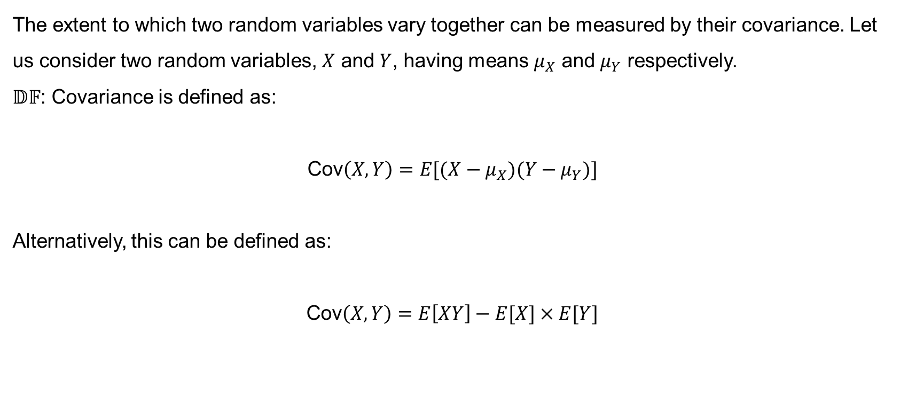
Covariance
The extent to which two random variables vary together can be measured by their covariance. Let us consider two random variables, $X$ and $Y$, having means $μ_{X}$ and $μ_{Y}$ respectively.
$𝔻𝔽$: Covariance is defined as:
$$\text{Cov}\left(X,Y\right)=E[(X−μ_{X})(Y−μ_{Y})]$$
Alternatively, this can be defined as:
$$\text{Cov}\left(X,Y\right)=E\left[XY\right]−E[X]×E[Y]$$

Slide 8
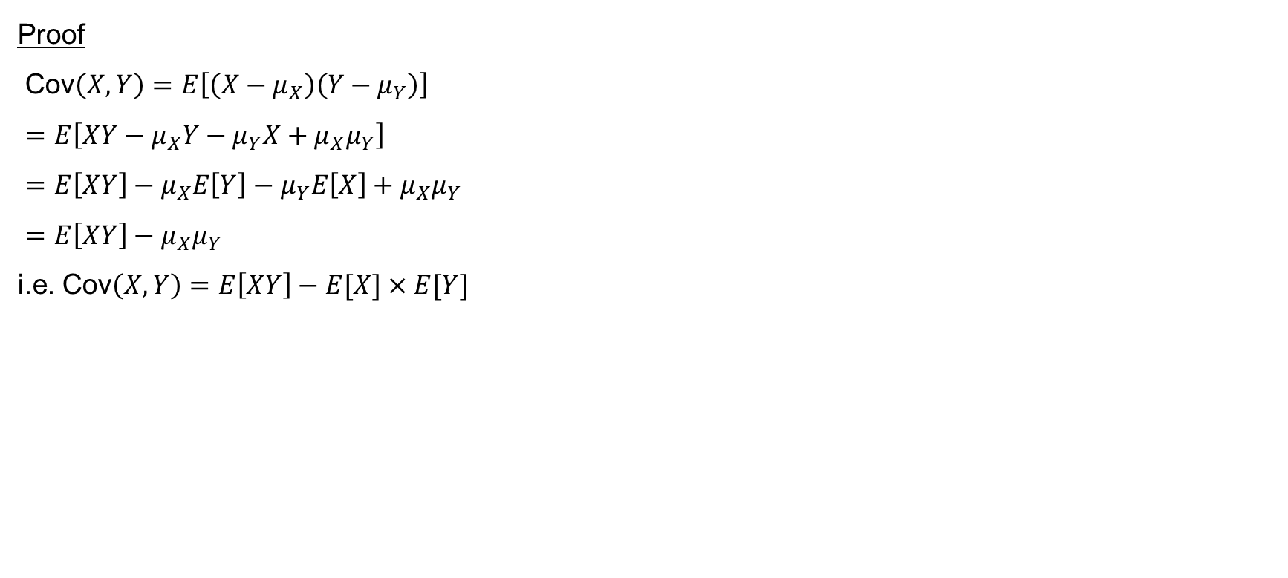
Proof I
Proof
$\text{Cov}\left(X,Y\right)=E\left[\left(X−μ_{X}\right)\left(Y−μ_{Y}\right)\right]$
$=E\left[XY−μ_{X}Y−μ_{Y}X+μ_{X}μ_{Y}\right]$
$=E\left[XY\right]−μ_{X}E\left[Y\right]−μ_{Y}E\left[X\right]+μ_{X}μ_{Y}$
$=E\left[XY\right]−μ_{X}μ_{Y}$
i.e. $\text{Cov}\left(X,Y\right)=E\left[XY\right]−E[X]×E[Y]$

Slide 9
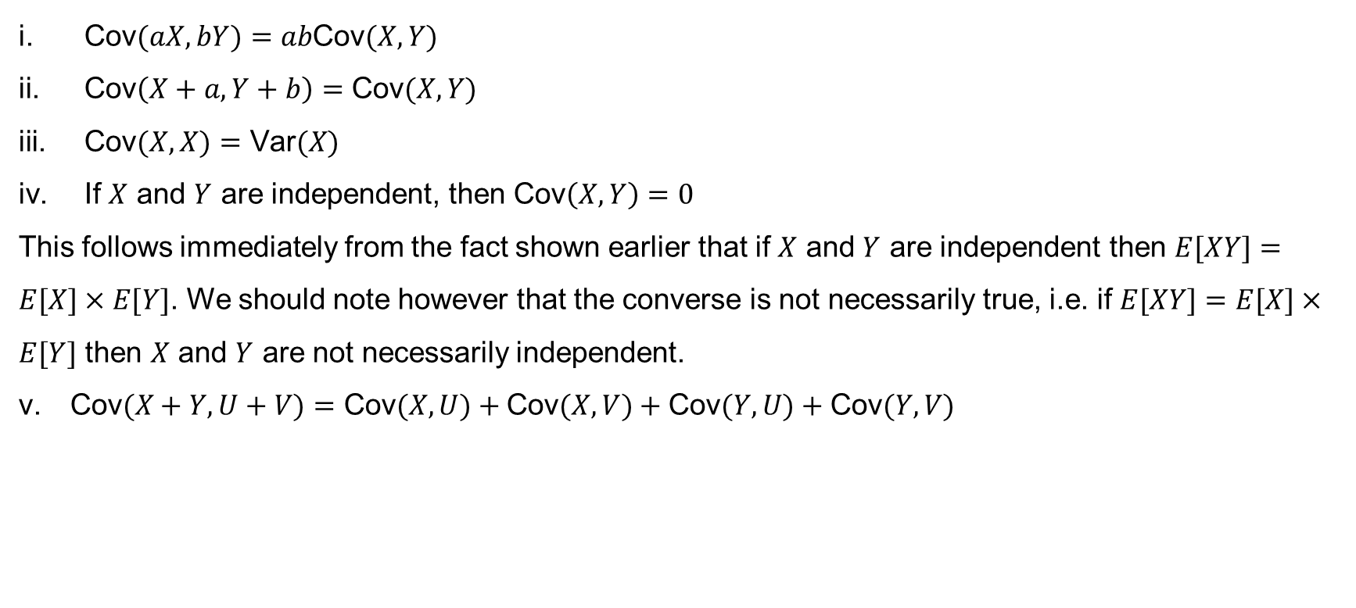
Properties of covariance
$\text{Cov}(aX,bY)=ab\text{Cov}(X,Y)$
$\text{Cov}\left(X+a,Y+b\right)=\text{Cov}(X,Y)$
$\text{Cov}(X,X)=\text{Var}(X)$
If $X$ and $Y$ are independent, then $\text{Cov}\left(X,Y\right)=0$
This follows immediately from the fact shown earlier that if $X$ and $Y$ are independent then $E[XY]=E[X]×E[Y]$. We should note however that the converse is not necessarily true, i.e. if $E[XY]=E[X]×E[Y]$ then $X$ and $Y$ are not necessarily independent.
$\text{Cov}(X+Y, U+V)=\text{Cov}(X,U)+\text{Cov}(X,V)+\text{Cov}(Y,U)+\text{Cov}(Y,V)$

Slide 10
Interpretation of covariance
Positive covariance indicates that higher than average values of one variable tend to be paired with higher than average values of the other variable.
Negative covariance indicates that higher than average values of one variable tend to be paired with lower than average values of the other variable.

Slide 11
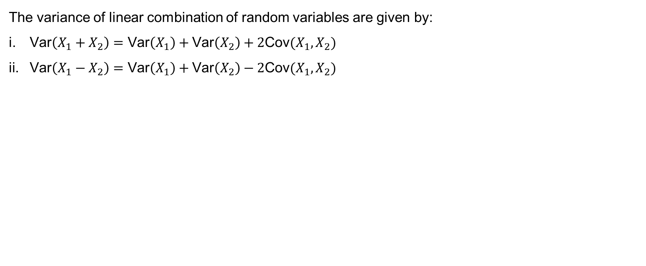
Variance of linear combination of random variables
The variance of linear combination of random variables are given by:
$\text{Var}\left(X_{1}+X_{2}\right)=\text{Var}\left(X_{1}\right)+\text{Var}\left(X_{2}\right)+2\text{Cov}(X_{1},X_{2})$
$\text{Var}\left(X_{1}−X_{2}\right)=\text{Var}\left(X_{1}\right)+\text{Var}\left(X_{2}\right)−2\text{Cov}(X_{1},X_{2})$

Slide 12

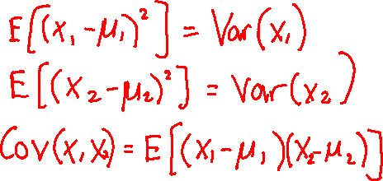
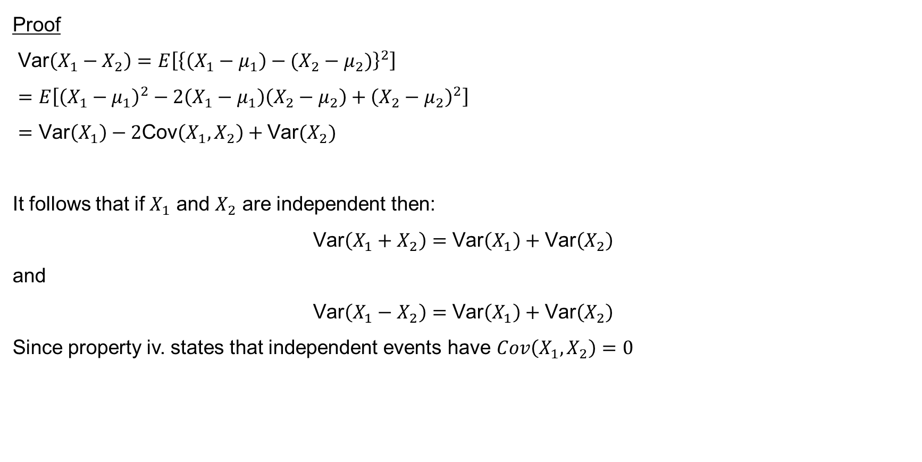





Proof II
Proof
$\text{Var}\left(X_{1}−X_{2}\right)=E\left[{\left\{\left(X_{1}−μ_{1}\right)−(X_{2}−μ_{2})\right\}}^{2}\right]$
$=E\left[{\left(X_{1}−μ_{1}\right)}^{2}−2\left(X_{1}−μ_{1}\right)\left(X_{2}−μ_{2}\right)+{\left(X_{2}−μ_{2}\right)}^{2}\right]$
$=\text{Var}\left(X_{1}\right)−2\text{Cov}\left(X_{1},X_{2}\right)+\text{Var}(X_{2})$
It follows that if $X_{1}$ and $X_{2}$ are independent then:
$$\text{Var}\left(X_{1}+X_{2}\right)=\text{Var}\left(X_{1}\right)+\text{Var}\left(X_{2}\right)$$
and
$$\text{Var}\left(X_{1}−X_{2}\right)=\text{Var}\left(X_{1}\right)+\text{Var}\left(X_{2}\right)$$
Since property iv. states that independent events have $Cov\left(X_{1}, X_{2}\right)=0$

Slide 13
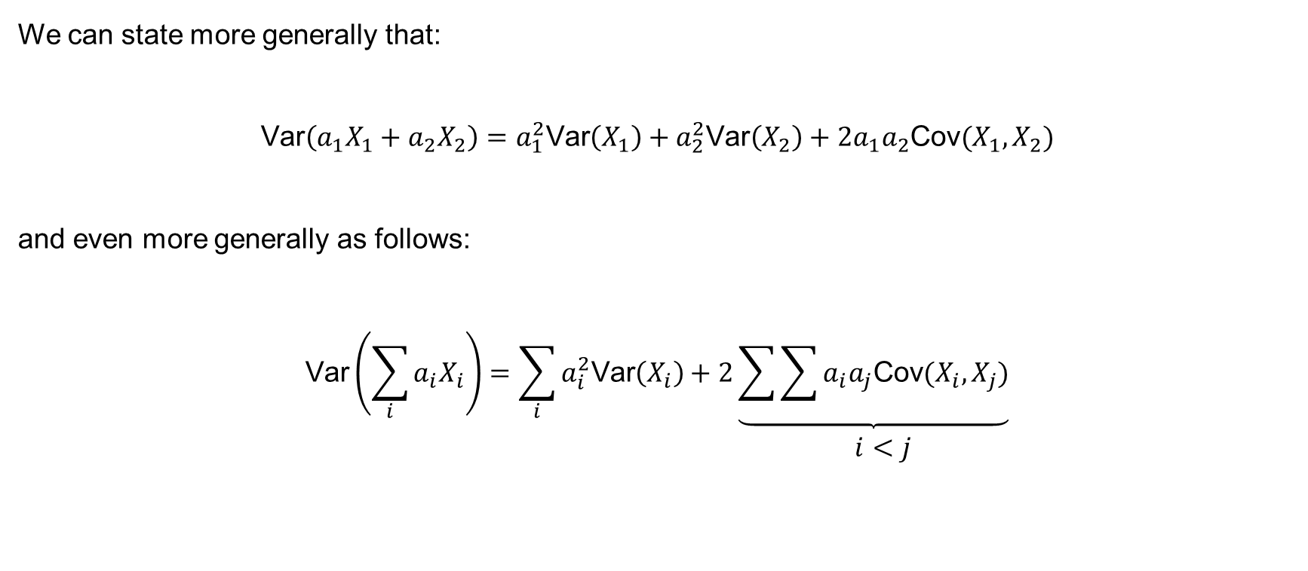
Proof II (continued)
We can state more generally that:
$$\text{Var}\left(a_{1}X_{1}+a_{2}X_{2}\right)=a_{1}^{2}\text{Var}\left(X_{1}\right)+a_{2}^{2}\text{Var}\left(X_{2}\right)+2a_{1}a_{2}\text{Cov}(X_{1},X_{2})$$
and even more generally as follows:
$$\begin{matrix}\text{Var}\left(\sum_{i}{a_{i}X_{i}}\right)=\sum_{i}{a_{i}^{2}\text{Var}\left(X_{i}\right)+2\underbrace{\sum{\sum{a_{i}a_{j}\text{Cov}(X_{i},X_{j})}}}} \\ i<j\end{matrix}$$

Slide 14
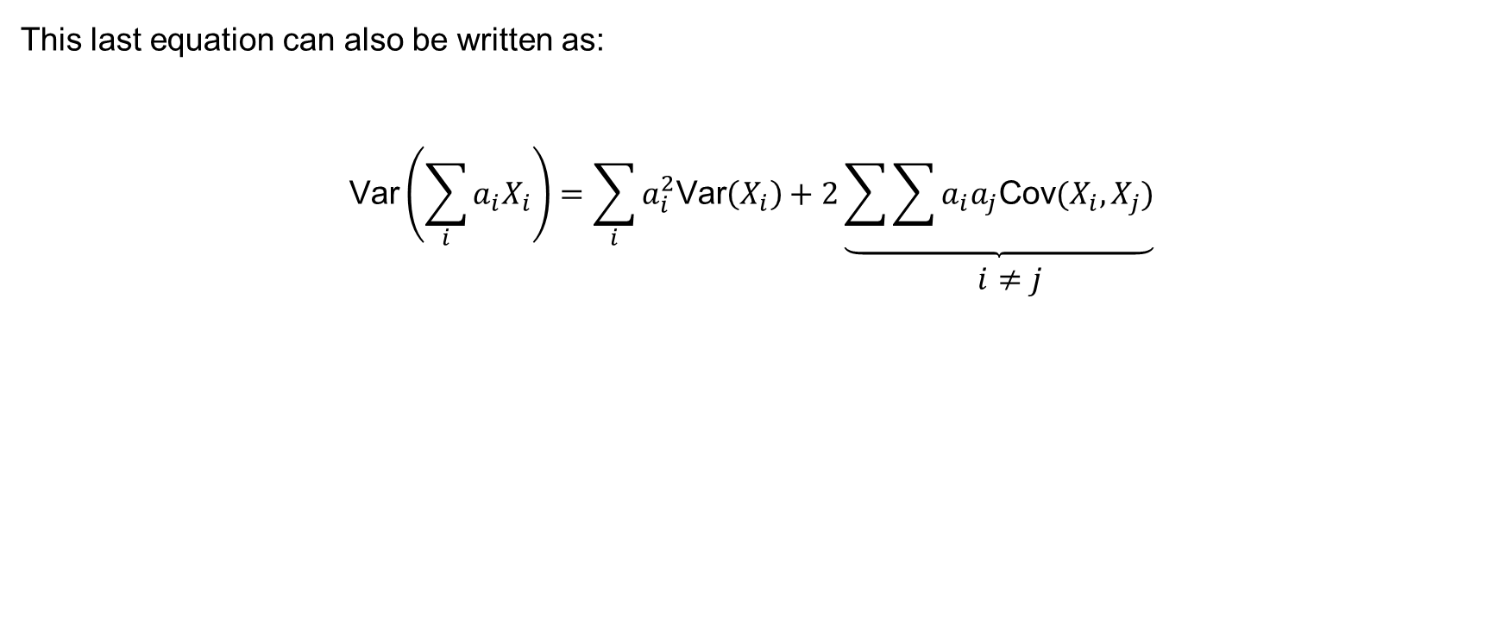
Proof II (continued)
This last equation can also be written as:
$$\begin{matrix}\text{Var}\left(\sum_{i}{a_{i}X_{i}}\right)=\sum_{i}{a_{i}^{2}\text{Var}\left(X_{i}\right)+2\underbrace{\sum{\sum{a_{i}a_{j}\text{Cov}(X_{i},X_{j})}}}} \\ i≠j\end{matrix}$$

Slide 15
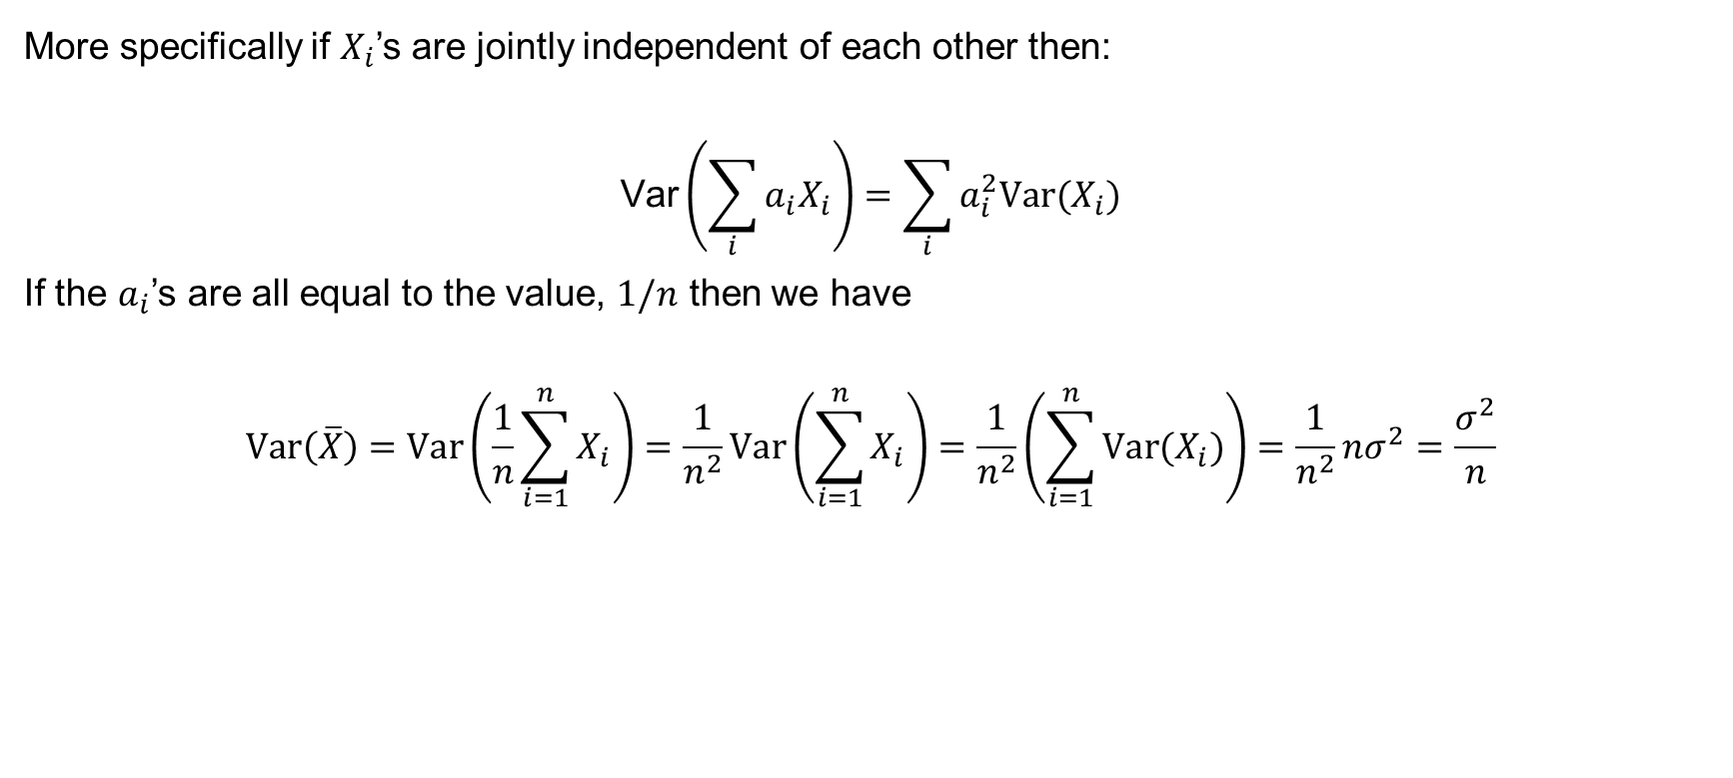
Proof II (continued)
More specifically if $X_{i}$’s are jointly independent of each other then:
$$\text{Var}\left(\sum_{i}{a_{i}X_{i}}\right)=\sum_{i}{a_{i}^{2}\text{Var}(X_{i})}$$
If the $a_{i}$’s are all equal to the value, $1/n$ then we have
$$\text{Var}\left(\overline{X}\right)=\text{Var}\left(\frac{1}{n}\sum_{i=1}^{n}{X_{i}}\right)=\frac{1}{n^{2}}\text{Var}\left(\sum_{i=1}^{n}{X_{i}}\right)=\frac{1}{n^{2}}\left(\sum_{i=1}^{n}{{\text{Var}(X}_{i})}\right)=\frac{1}{n^{2}}nσ^{2}=\frac{σ^{2}}{n}$$

Slide 16
Sums of independent random variables from known distributions
Sums of independent random variables from a common family of distributions are often also from the same family.

Slide 17
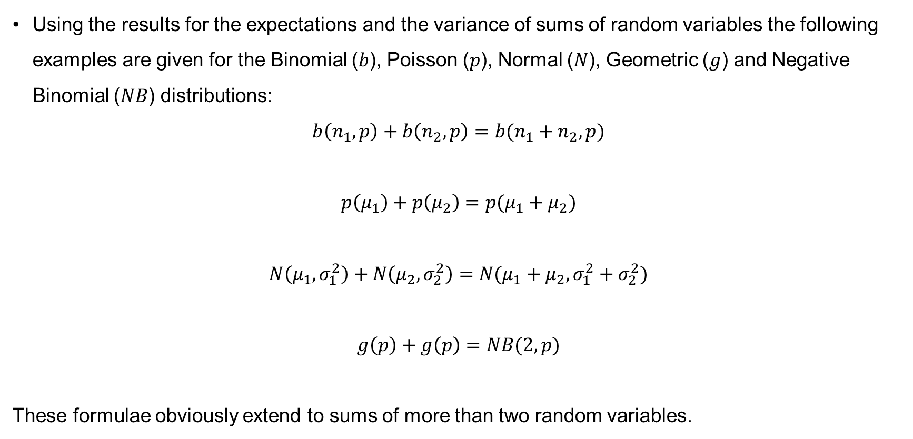
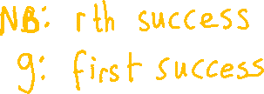
Examples of known distributions
Using the results for the expectations and the variance of sums of random variables the following examples are given for the Binomial ($b$), Poisson ($p$), Normal ($N$), Geometric ($g$) and Negative Binomial ($NB$) distributions:
$$b\left(n_{1},p\right)+b\left(n_{2},p\right)=b(n_{1}+n_{2},p)$$
$$p\left(μ_{1}\right)+p\left(μ_{2}\right)=p(μ_{1}+μ_{2})$$
$$N\left(μ_{1},σ_{1}^{2}\right)+N\left(μ_{2},σ_{2}^{2}\right)=N(μ_{1}+μ_{2}, σ_{1}^{2}+σ_{2}^{2})$$
$$g\left(p\right)+g\left(p\right)=NB(2,p)$$
These formulae obviously extend to sums of more than two random variables.

Slide 18
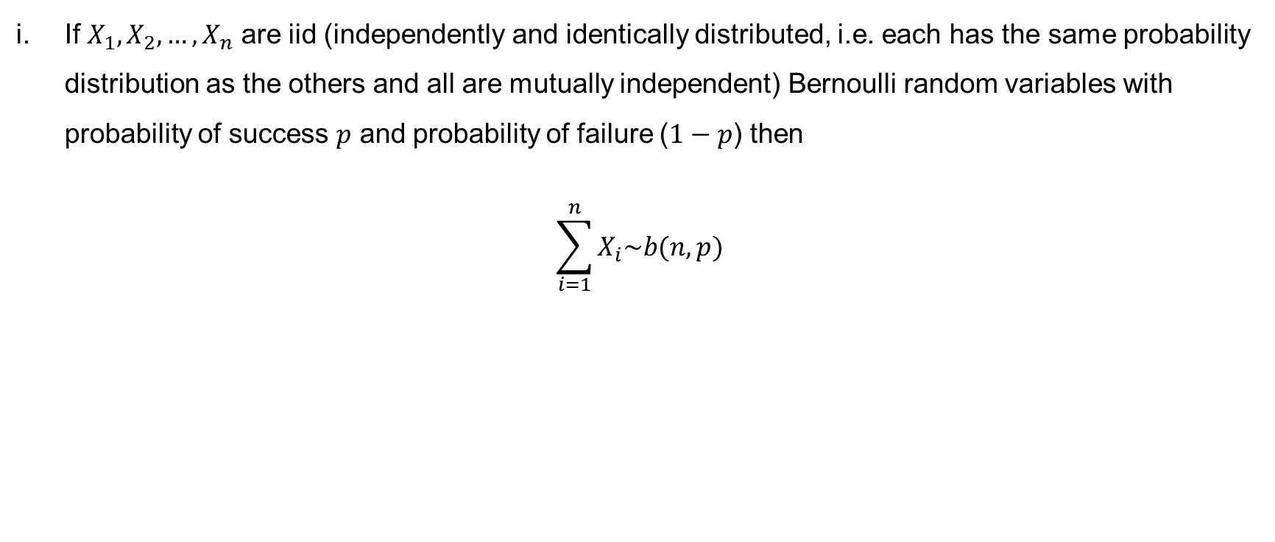
Binomial
If $X_{1}, X_{2}, …, X_{n}$ are iid (independently and identically distributed, i.e. each has the same probability distribution as the others and all are mutually independent) Bernoulli random variables with probability of success $p$ and probability of failure ($1−p$) then
$$\sum_{i=1}^{n}{X_{i}\sim b(n,p)}$$

Slide 19
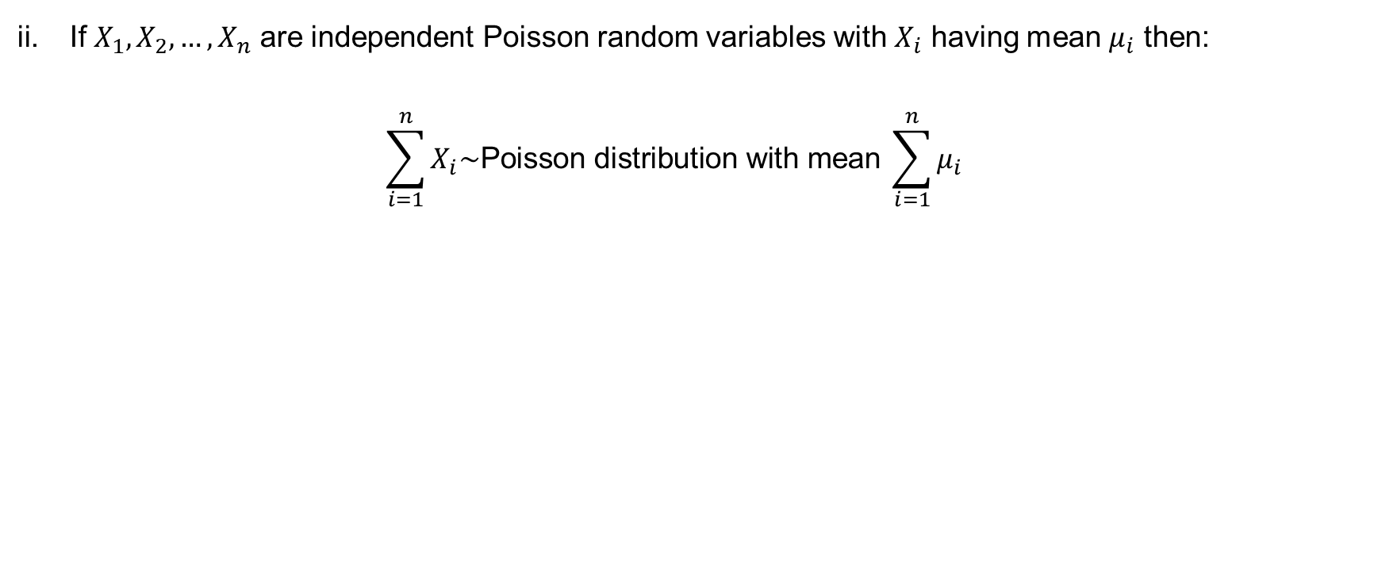
Poisson
If $X_{1}, X_{2}, …, X_{n}$ are independent Poisson random variables with $X_{i}$ having mean $μ_{i}$ then:
$$\sum_{i=1}^{n}{X_{i}\sim \text{Poisson} \text{distribution} \text{with} \text{mean} \sum_{i=1}^{n}{μ_{i}}}$$

Slide 20
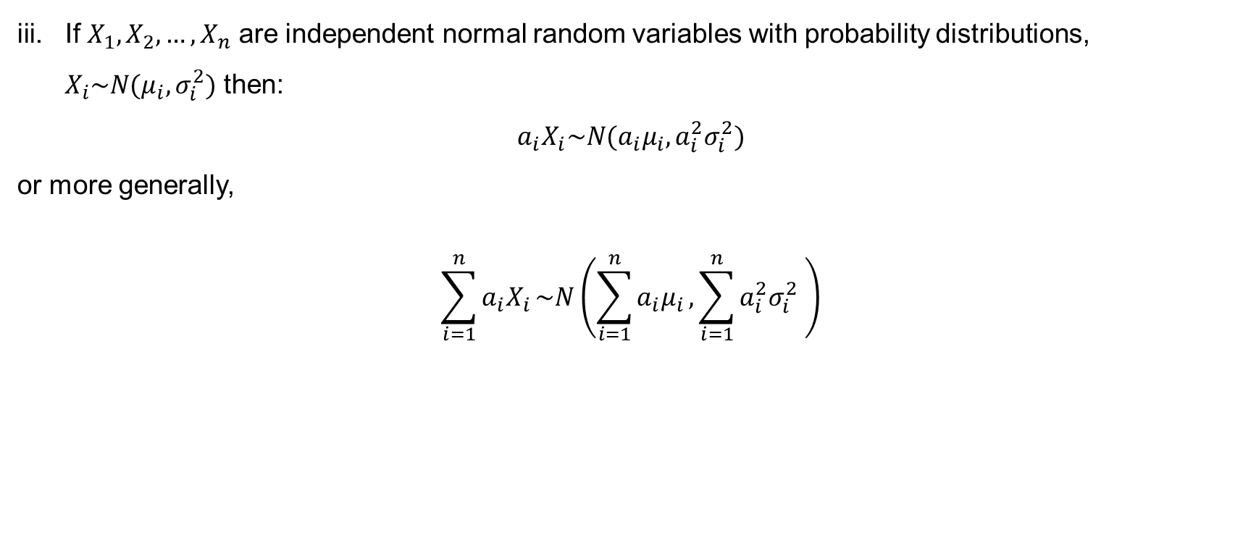
Normal
If $X_{1}, X_{2}, …, X_{n}$ are independent normal random variables with probability distributions, $X_{i}\sim N(μ_{i},σ_{i}^{2})$ then:
$$a_{i}X_{i}\sim N(a_{i}μ_{i}, a_{i}^{2}σ_{i}^{2})$$
or more generally,
$$\sum_{i=1}^{n}{a_{i}X_{i}}\sim N\left(\sum_{i=1}^{n}{a_{i}μ_{i}},\sum_{i=1}^{n}{a_{i}^{2}σ_{i}^{2}} \right)$$

Slide 21
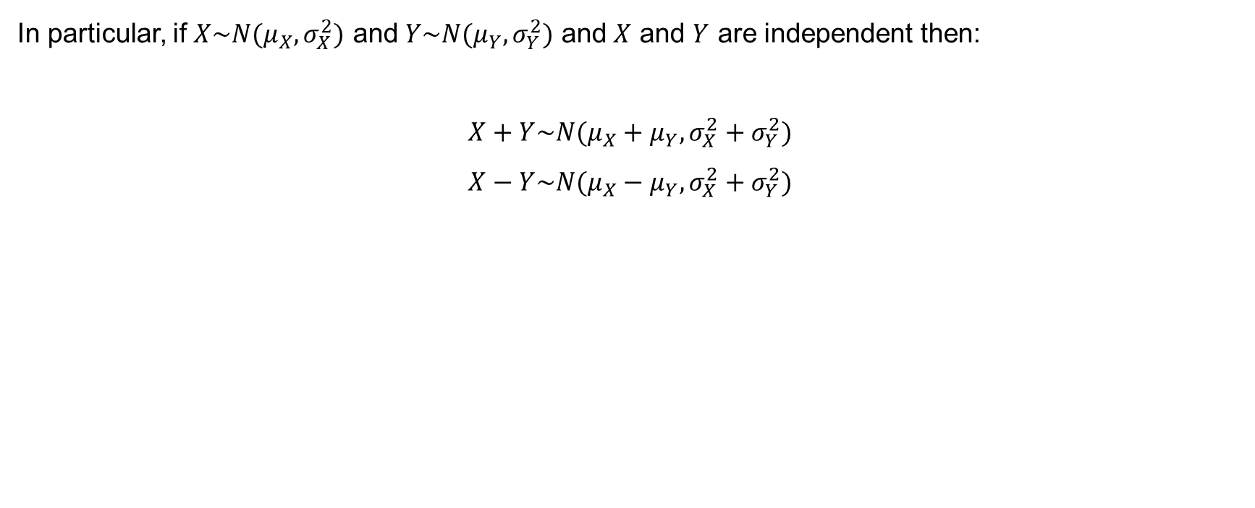
Normal (continued)
In particular, if $X\sim N(μ_{X},σ_{X}^{2})$ and $Y\sim N(μ_{Y},σ_{Y}^{2})$ and $X$ and $Y$ are independent then:
$$X+Y\sim N(μ_{X}+μ_{Y}, σ_{X}^{2}+σ_{Y}^{2})$$
$$X−Y\sim N(μ_{X}−μ_{Y}, σ_{X}^{2}+σ_{Y}^{2})$$

Slide 22
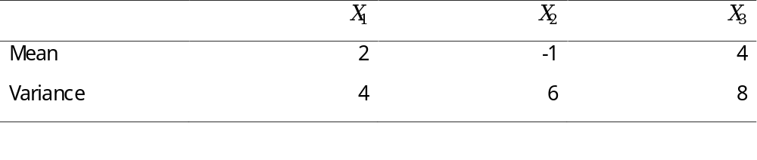
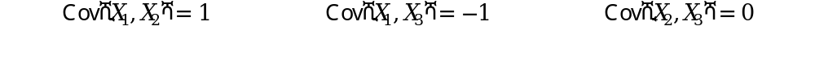
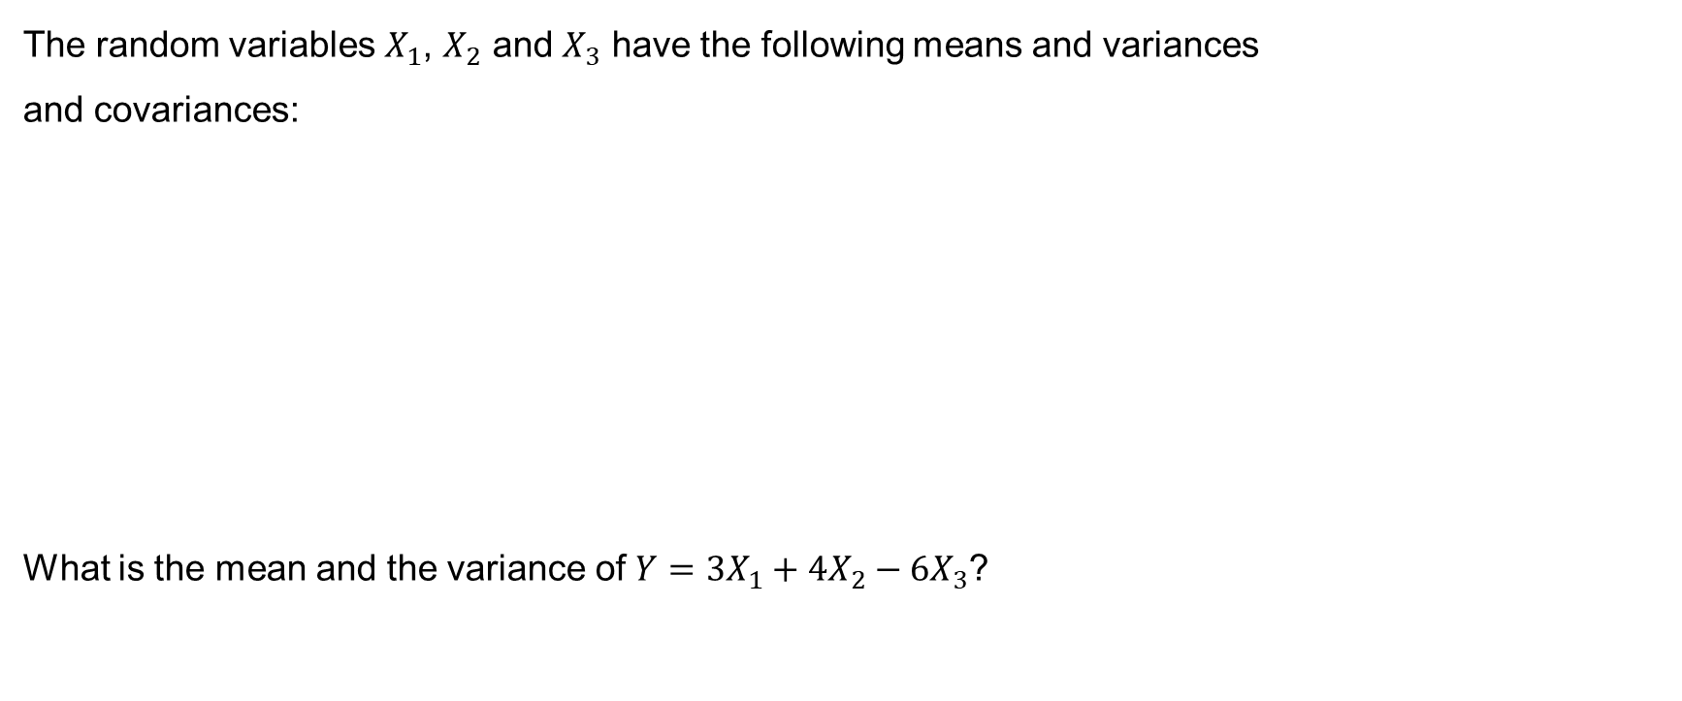
Example 9.2
The random variables $X_{1}$, $X_{2}$ and $X_{3}$ have the following means and variances
and covariances:
What is the mean and the variance of $Y=3X_{1}+4X_{2}−6X_{3}$?

Slide 23

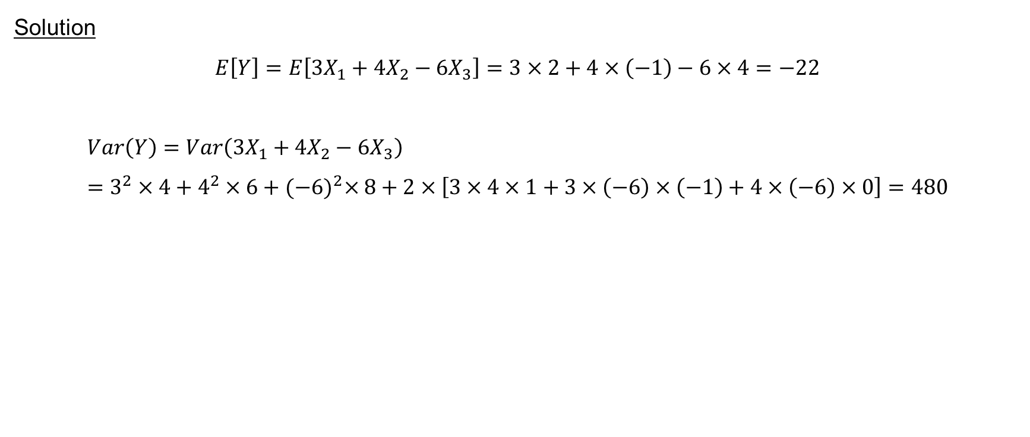
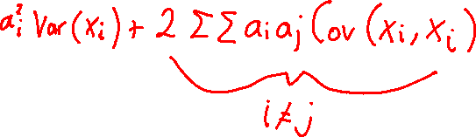



Example 9.2 (continued)
Solution
$$E\left[Y\right]=E\left[3X_{1}+4X_{2}−6X_{3}\right]=3×2+4×\left(−1\right)−6×4=−22$$
$$Var\left(Y\right)=Var\left(3X_{1}+4X_{2}−6X_{3}\right)=3^{2}×4+4^{2}×6+{(−6)}^{2}×8+2×\left[3×4×1+3×\left(−6\right)×\left(−1\right)+4×\left(−6\right)×0\right]=480$$

Slide 24
Next time
Introduce correlation coefficient and explore how this relates to covariance

